Slide 1
An Introduction to Criminology
Day 1: Intro and Micro-Level Theories
Poll Question: Have you heard of criminology before signing up for this course? (Use Yes/No in the participants window)

Slide 2
Syllabus Highlights
There is no required homework for this class!
Though the homework is usually short and can only benefit you
All readings will be provided or can be found with a quick Google search
The first three classes focus on criminological theories; The last three classes focus on applications (subject to change depending on how fast/slow we go)
Emails and questions
There are ~160 of you! (which is amazing)
I will create a weekly compilation of your questions with answers to send out to everyone
(refer to the syllabus if you do not wish to have your questions in the compilation)
Slides will be sent out in Powerpoint/PDF format the next day
Feel free to ask questions about what you have missed

Slide 3
Some important notes
As you might have guessed, criminology is all about criminal behavior, which has ties with law enforcement, the law in general, and politics…
In this class, we will be focusing on criminological theories and observations, but one of the goals of criminology is to figure out how to reduce crime
You are more than welcome to propose various solutions on how to reduce crime
One of the skills that you may be learning in school is how to write a counterargument
This involves looking at both sides of an argument
This also involves creating claims with good evidence and analysis
Please be respectful when listening to views that may oppose (or even support) you own views
Want to bring in the concepts of Diversity, Equity, and Inclusion
Playlist of Middle Ground: https://www.youtube.com/watch?v=3SjuC0PYscU&list=PLBVNJo7nhINSjBZdNezW15PzOTCc-10m9

Slide 4
Question 1
Which question do criminologists try to answer?
How can someone be convicted of a crime?
What does the evidence from the crime scene tell us?
What is the “perfect” crime?
Why do people do crime?

Slide 5
Question 1(Answer)
Which question do criminologists try to answer?
How can someone be convicted of a crime? (more for lawyers)
What does the evidence from the crime scene tell us? (more for forensics)
What is the “perfect” crime? (more of a thought experiment)
Why do people do crime?

Slide 6
What is Criminology?
If you look up the definition...
According to Google, “The scientific study of crime and criminals”
According to Wikipedia, “The study of crime and deviant behavior”
What do criminologists do?
Why do people do crime?
Mindset and motivations
Figure out how to reduce/prevent crime

Slide 7
Fun Slide
Besides Tom Cruise, what do these two movies have in common?
Both involve the prediction of the future (though The Minority Report is about pre-crime)

Slide 8
Criminological Theories Overview

Slide 9
Dividing Up Criminological Theories
Micro (today and next week):
Individual
Rational Choice
Routine Activities
Biological/Biosocial
Psychological
Social Process
Differential Association
Social Learning
Self-Control
These theories are more about the criminals themselves
Macro (two weeks from now):
Structural
Social Disorganization
Anomie/Strain
Critical
Critical
Radical
Feminist
Postmodernism
Cultural
Peacemaking
Restorative Justice
These theories are more about the “system”

Slide 10
Micro-Level Theories

Slide 11
Rational Choice Theory
Let’s consider the benefits and downsides of robbing a bank…
What are some of the benefits? (Type in the chat)
Quick money
Thrill
Something to brag about
What are some of the downsides?
Getting caught by police
Criminal record
Hurting other people
If the benefits of undertaking deviant behavior outweigh the downsides, then the crime will be committed

Slide 12
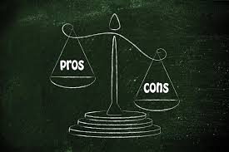
Rational Choice Theory
Advantages
Relatively intuitive and straightforward
Easy to apply
Similar line of logic found in economics, other areas of psychology, etc.
Disadvantages
Assumption that everyone is rational…
Influence of alcohol or drugs?
Criminal behavior is stressful
Benefits/Downsides hold different values between different people
Limited information to make decisions

Slide 13
Question 2
Let’s try to rob a bank again. Under which conditions do you think a crime is most likely to occur (assume the only crime possible is robbing a bank)?
A potential offender knows that there is no money to steal in the bank, but there is plenty of security
A regular person knows that there is $1 million to steal in the bank, and there is plenty of security
A potential offender knows that there is $1 million to steal in the bank, and there is no security
A potential offender knows that there is $1 million to steal in the bank, and there is plenty of security

Slide 14
Question 2 (answer)
Let’s try to rob a bank again. Under which conditions do you think a crime is most likely to occur (assume the only crime possible is robbing a bank)?
A potential offender knows that there is no money to steal in the bank, but there is plenty of security
A regular person knows that there is $1 million to steal in the bank, and there is plenty of security
A potential offender knows that there is $1 million to steal in the bank, and there is no security
A potential offender knows that there is $1 million to steal in the bank, and there is plenty of security

Slide 15
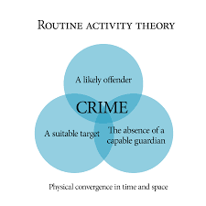
Routine Activities Theory
There are 3 parts to Routine Activities theory…
Willing offender
Absence of a willing offender means that nothing happens
Suitable target
Without a target/goal, there is no purpose in doing the crime
Absence of a guardian
Examples: Police officers, Security officers, security cameras, alarms, etc.
Without a guardian, there is less resistance
All 3 parts must be fulfilled for crime to occur (according to the theory)

Slide 16
Question 3
In the late 20th century, the number of TVs in American households has dramatically increased. What effect did the increase in number of TVs have on the crime rate for home burglaries?
The crime rate went up
The crime rate went down
The crime rate remained the same (only applies to home burglaries)

Slide 17
Question 3 (answer)
In the late 20th century, the number of TVs in American households has dramatically increased. What effect did the increase in number of TVs have on the crime rate for home burglaries?
The crime rate went up
The crime rate went down
The crime rate remained the same (only applies to home burglaries)
Explanation: It depends on how you see it (both trends observed)
More TVs → more targets
More TVs → people staying at home (guardian)

Slide 18
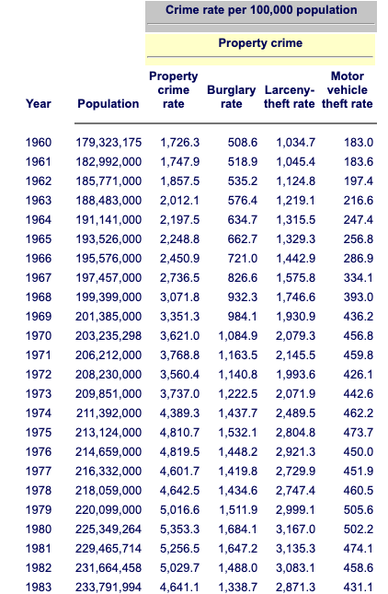
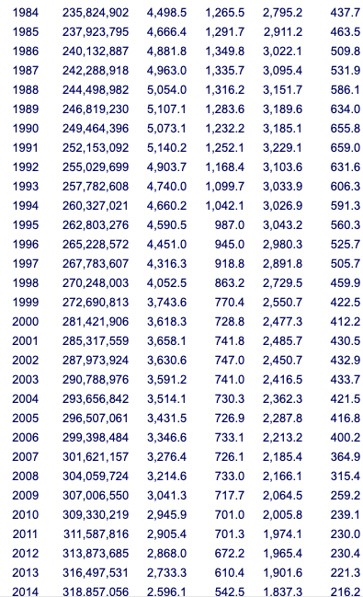
Property Crime Rate since 1960
Higher crime rates in 80s
Rise of crack-cocaine market
Increase from 60s to 80s
Decline from 90s to present
(Property crime also includes commercial areas)

Slide 19
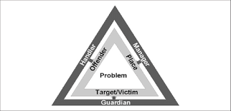
Routine Activities Theory
Advantages
Relatively intuitive
Easy to apply
Proposes solutions (e.g. increase security)
Applications in forensic accounting
Unshareable problem (similar to willing offender)
Access to resources (similar to suitable target)
Trust within ranks (similar to absence of guardian)
Disadvantages
Can lead to conflicting conclusions
Oversimplified?
Certainly, crime is more complicated than just 3 things

Slide 20
Question 4
Freud developed interesting theories in the field of psychology, one of which is the psychodynamic theory. Listed are three crucial components (in letters) and their associated “terms” (in numbers).
A. Id
B. Ego
C. Superego
In the chat, type out which component matches which term. An example response would be “A=2,B=1,C=3”
1. Mediator
2. Primitive/Instincts
3. Morals

Slide 21
Question 4 (answer)
Freud developed interesting theories in the field of psychology, on of which is the psychodynamic theory. Listed are three crucial components (in letters) and their associated “terms” (in numbers).
A. Id
B. Ego
C. Superego
In the chat, type out which component matches which term. An example response would be “A=2,B=1,C=3” ← This was the answer!
1. Mediator
2. Primitive/Instincts
3. Morals

Slide 22
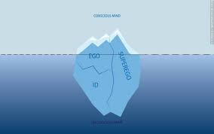
Psychological Theories
Psychodynamic theory
Id: Primitive/Instincts
Pleasure principle (i.e. gratification)
Criminals having no concern for anyone but themselves
Superego: Morals
Moral standards and values from community, parents, friends, etc.
Ego: Mediates between Id and Superego
Reality principle
Following rules/boundaries (e.g. not crying while waiting in line)
Theory suggests criminal offenders are frustrated and aggravated (why might this be the case?)
Underdeveloped superego
Weak ego

Slide 23
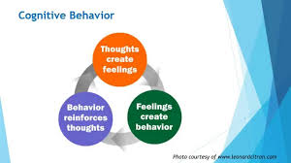
Psychological Theories
Behavioral Theory
Human behavior is learned
Social learning theory (Bandura)
Humans are not born bad
Learn through family, experiences (such as living in a crime prone areas), media (violence, desensitization)
Cognitive Theory
Individual’s perception of the world and how this perception is developed
Moral development → how to develop morals and reason
Information processing → acquiring, retaining, and retrieving information
Nature vs. Nurture debate

Slide 24
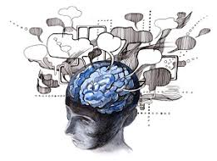
Psychological Theories
Advantages:
Points out to specific areas of concern
Ex: For behavior theory, place a child in a safe learning environment
Can support rational choice theory
How does one view something as good/bad?
Disadvantages
Nature vs. Nurture debate
More likely that both have some effect on behavior
Question is how much of an impact does nature have relative to nurture?
Contradictions between theories
Ex: Freud’s Id suggests that some behavior is innate while Bandura’s behavior theory does not allow this
Complex
Could be a good thing in better understanding behavior
More difficult to propose solutions to prevent crime

Slide 25
Optional: Biological Theory
Theory suggests that one’s phenotype can act as a predictor of crime
Deterministic (i.e. already determined to do crime)
Largely debunked
Seems ridiculous how the shape of your nose or forehead could be an accurate predictor of crime
Gave way to studying neurotransmitters, which do have psychological effects
Consider effects of drugs
Important idea to consider: Correlation =/= Causation
In 19th and early 20th centuries, people were finding correlations between phenotypes and crime rates
But no scientific basis

Slide 26
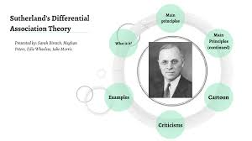
Differential Association Theory (If time…)
(continuation of social learning theory)
There are ~9 statements, but we will focus on only 2
Criminal behavior is learned
A person is delinquent if they have more definitions that favor criminal behavior over lawful behavior
In other words, a person’s overall beliefs tend to favor criminal behavior
Advantages
Aligns with social learning theories (behavior is learned)
9 statements specifically point to origins of criminal behavior → possibly easier to enact policies to fix these issues
Disadvantages
Assumes that people are not inherently bad/unlawful (on the flipside, good/lawful)
Contradicts deterministic theories (i.e. your behavior is already predetermined; fate)

Slide 27
Final Poll Questions
Of all the theories we’ve covered so far, which do you think is the most intuitive or understand the most? Which do you think needs more explanation?
Rational choice theory (weighing pros and cons)
Routine activities theory (willing offender, suitable target, absent guardian)
Psychodynamic theory (Id, Ego, Superego)
Behavioral Theory (behavior is learned)
Cognitive Theory (processing information)
Biological Theory (phenotypes and neurotransmitters)
Differential Association Theory (learned behavior and definitions)
(Don’t include G if we have not covered it…)

Slide 28
Final Poll Question Prediction
My guesses for responses to the final poll question.
Most intuitive: Rational choice or Routine activities
Needs more explanation: Cognitive

Slide 29
“Homework”
Read a little bit about biological and biosocial theories…
Ask questions via email (will be compiled into a big email unless you otherwise specify)
Remember that all correspondence will be recorded
See you next week!

